Slide 1
Module-1
The Role of SQA- Software Quality Assurance Plan-Software Quality Assurance considerations-Need of Software Quality Assurance -SQA People

Slide 2
Software – IEEE definition
Software is:
Computer programs, procedures, and possibly associated documentation and data pertaining to the operation of a computer system
• Quality is defined as a characteristics or attributes of something where as attributes refer to measurable characteristics-things that we are able to compare to known standards.

Slide 3
What is Quality and Assurance
Quality is extremely hard to define, and it is simply stated: "Fit for use or purpose." It is all about meeting the needs and expectations of customers with respect to functionality, design, reliability, durability, & price of the product.
Assurance is nothing but a positive declaration on a product or service, which gives confidence. It is certainty of a product or a service, which it will work well. It provides a guarantee that the product will work without any problems as per the expectations or requirements.

Slide 4
What is Quality Assurance?
Quality Assurance (QA) is defined as an activity to ensure that an organization is providing the best possible product or service to customers. QA focuses on improving the processes to deliver Quality Products to the customer. An organization has to ensure, that processes are efficient and effective as per the quality standards defined for software products. Quality Assurance is popularly known as QA Testing

Slide 5
Software quality – IEEE definition
Software quality is:
1. The degree to which a system, component, or process meets specified requirements.
2. The degree to which a system, component, or process meets customer or user needs or expectations.

Slide 6
Software quality – Pressman’s definition
Software quality is defined as:
Conformance to explicitly stated functional and performance requirements, explicitly documented development standards, and implicit characteristics that are expected of all professionally developed software

Slide 7
Software quality assurance – The IEEE definition
Software quality assurance is:
1. A planned and systematic pattern of all actions necessary to provide adequate confidence that an item or product conforms to established technical requirements.
2. A set of activities designed to evaluate the process by which the products are developed or manufactured. Contrast with quality control

Slide 8
SQA – expanded definition
Software quality assurance is:
A systematic, planned set of actions necessary to provide adequate confidence that the software development process or the maintenance process of a software system product conforms to established functional technical requirements as well as with the managerial requirements of keeping the schedule and operating within the budgetary confines

Slide 9
What are SQA, SQP, SQC, and SQM?
SQA includes all 4 elements…
Software Quality Assurance – establishment of network of organizational procedures and standards leading to high-quality software
Software Quality Planning – selection of appropriate procedures and standards from this framework and adaptation of these to specific software project
Software Quality Control – definition and enactment of processes that ensure that project quality procedures and standards are being followed by the software development team
Software Quality Metrics – collecting and analyzing quality data to predict and control quality of the software product being developed

Slide 10
Software Quality Assurance vs. Software Quality Control
Quality Control is defined as a designed to evaluate the quality of a set of activities developed or manufactured product
We have QC inspections during development and before deployment
QC activities are only a part of the total range of QA activities.
Quality Assurance’s objective is to minimize the cost of guaranteeing quality by a variety of activities performed throughout the development / manufacturing processes / stages.
Activities prevent causes of errors; detect and correct them early in the development process
QA substantially reduces the rate of products that do not qualify for shipment and/at the same time, reduce the costs of guaranteeing quality in most cases.

Slide 11
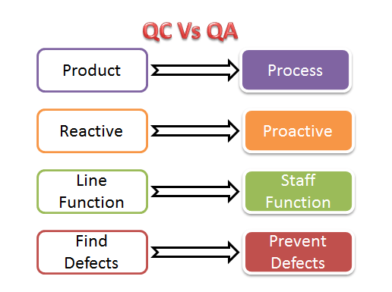

Slide 13
Best practices for Quality Assurance:
Create a Robust Testing Environment
Select release criteria carefully
Apply automated testing to high-risk areas to save money. It helps to fasten the entire process.
Allocate Time Appropriately for each process
It is important to prioritize bugs fixes based on software usage
Form dedicated security and performance testing team
Simulate customer accounts similar to a production environment

Slide 14
Differences between SQA and Software Testing

Slide 15
Quality Assurance Functions:
Technology transfer: This function involves getting a product design document as well as trial and error data and its evaluation. The documents are distributed, checked and approved
Validation: Here validation master plan for the entire system is prepared. Approval of test criteria for validating product and process is set. Resource planning for execution of a validation plan is done.
Documentation: This function controls the distribution and archiving of documents. Any change in a document is made by adopting the proper change control procedure. Approval of all types of documents.
Assuring Quality of products
Quality improvement plans

Slide 17
Software metrics can be classified into three categories:
Product Metrics,
Process Metrics, and
Project Metrics.
Product metrics describe the characteristics of the product such as size, complexity, design features, performance, and quality level.
Process metrics can be used to improve software development and maintenance.
Examples include the effectiveness of defect removal during development, the pattern of testing defect arrival, and the response time of the fix process.

Slide 18
Project Metrics describe the project characteristics and execution.
Examples include the number of software developers, the staffing pattern over the life cycle of the software, cost, schedule, and productivity.
Some metrics belong to multiple categories. For example, the inprocess quality metrics of a project are both process metrics and project metrics.

Slide 19
The objectives of SQA activities
in Software Development (Process-Oriented)
Assuring an acceptable level of confidence that the software will conform to functional technical requirements.
Assuring an acceptable level of confidence that the software will conform to managerial scheduling and budgetary requirements.
(3) Initiation and management of activities for the improvement and greater efficiency of software development and SQA activities.

Slide 20
The objectives of SQA activities
in Software Maintenance (product-oriented)
Assuring an acceptable level of confidence that the software maintenance activities will conform to the functional technical requirements.
Assuring an acceptable level of confidence that the software maintenance activities will conform to managerial scheduling and budgetary requirements.
(3) Initiate and manage activities to improve and increase the efficiency of software maintenance and SQA activities.

Slide 21
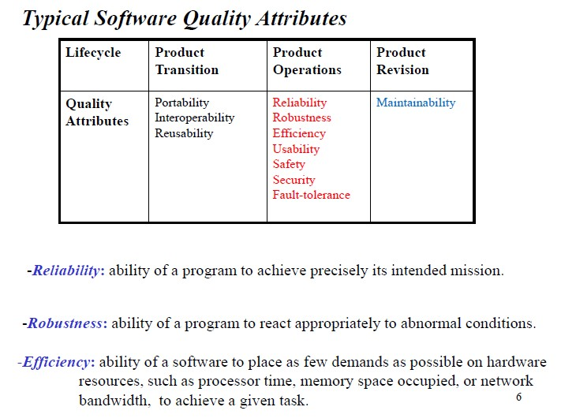

Slide 22
Typical Quality Attributes
Usability: effort required to learn, operate and use a program.
Safety: ability of the system to operate without catastrophic failure.
Fault-tolerance: ability of the system to continue operating after some system faults have manifested themselves.
Security: ability of the system to protect itself against accidental or deliberate intrusion.

Slide 23
Portability: effort required to transfer a program from one computing environment or platform to another.
Reusability: ability and effort required to reuse a program or part of a program in other applications.
Interoperability: effort required interconnecting or relating two different applications, running possibly in different computing environments
Maintainability: effort required modifying, _{updating,}Pr_{e}of._{v}Sh_{o}ai_{l}l_{v}es_{i}h_{n}T._{g}G,ah_{o}an_{r}e, _{r}D_{e}r. _{p}D _{a}Y P_{ir}a_{i}ti_{n}l S_{g}cho_{a}ol o_{p}f M_{ro}CA_{g}, P_{r}u_{a}ne_{m during}

Slide 24
SQA Activities
#Creating an SQA Management Plan:
# Setting the Checkpoints:
# Apply software Engineering Techniques:
# Executing Formal Technical Reviews:
# Having a Multi- Testing Strategy:
# Enforcing Process Adherence:
# Measure Change Impact:
Performing SQA Audits
# Maintaining Records and Reports:
#Manage Good Relations:

Slide 25
What's the Quality Assurance role?
The Quality Assurance (QA) role is the role responsible for guaranteeing a level of quality for the end client, and to help the software development team to identify problems early in the process
The quality assurance role is split into three parts:
First The role creates test cases and scripts. Second The role executes or supervises the execution of those test cases and scripts. Third The role facilitates or performs random testing of all components to ensure that there's not a random bug haunting the system.

Slide 26
ROLE OF QUALITY ASSURANCE IN SOFTWARE DEVELOPMENT
Different activities of SQA are as follows
Maintaining the quality of the system as per the specification and business requirements.
Defect prevention and formal methods for other defect prevention technique.
Defect Reduction
Direct fault detection and removal without executing the project scenario.
Testing the project for Failure observation and bug removal.
Risk identification
Defect tracking techniques and methods. Software fault tolerance. Concluding remarks and maintaining reports.
Prepares an SQA plan for a project
Participates in the development of the project's software process description.
Reviews software engineering activities to verify compliance with the defined software process.
Audits designated software work products to verify compliance with those defined as part of the software process.
Ensures that deviations in software work and work products are documented and handled according to a documented procedure.
Records any noncompliance and reports to senior management.

Slide 27
ROLE OF QUALITY ASSURANCE IN SOFTWARE DEVELOPMENT
Senior Software Quality Assurance (SQA) Engineer
Coach and mentor SQA Engineers and QA Analysts in execution of testing efforts
Coordinate the work efforts of Engineers and Analysts in the execution of testing efforts
Lead effort to review product specifications and work with others to develop appropriate test strategies and detailed test plans and test architectures
Lead formal reviews of test plans, designs and requirements documents with cross-functional teams
Accurately predict the amount of effort required for projects and tasks. Develop plans and schedules based on these predictions
Architect, implement and manage automated suites of black-box and white-box test scripts
Identify product issues and write detailed bug reports during the product development cycle
Communicate and coordinate with peers and senior level individuals in cross-functional groups to articulate and compare alternative testing approaches
Lead defect management and maintenance. Review defects that escaped to the field to learn how they could have been prevented or detected
Lead documentation reviews during product release cycle to ensure quality and comprehensive product documentation
Lead monitoring of test execution across multiple code branches and multiple platforms
Research, Develop and/or Recommend tools to assist SQA Engineers and QA Analysts in test planning, execution and reporting
Utilize tools such as code coverage tools to assess the coverage of test suites and make recommendations for additional test cases

Slide 28
Software Quality Assurance (QA) Engineer Duties & Responsibilities
Document test cases
Perform and document risk analysis
Record test progress and results
Code automated tests
Create test plans
Develop standards and procedures to determine product quality and release readiness
Discover bugs within software
Drive innovation and streamline overall testing processes
Identify, isolate, and track bugs throughout testing
Identify any potential problems that users might encounter
Perform manual and automated testing
Research and analyze product features being tested
Research new tools, technologies, and testing processes
Review user interfaces for consistency and functionality

Slide 29
Software Quality Assurance (QA) SQA Test Engineer Duties & Responsibilities
Produce Device Test Plans, Test Cases and Test Reports for software projects
• Assist SQA Manager in maintaining and improving test processes
• Assist SQA Manager in maintaining computers and infrastructure in the QA Test Lab
• Perform manual testing on Oncam products to discover any software bugs that are present
• Be able to produce clear and well written bug reports
• Verify that bugs have been fixed in a software release
• Provide estimation of timescales for project work when required
• Add tests to the automated test framework already in place
• Perform any other duties as required by the SQA Manager
• Maintain part of our automated test frameworks.

Slide 30
Software quality can be quantified into two major groups
Software function quality: it basically shows how well a software product conforms to the basic design, based on functional requirements.
Software structural quality: It reflects on how well the project meets the non functional requirement such as usability, accessibility and security that helps in proper the delivery of the requirement.

Slide 31
Content of SQAP - Software Quality Assurance Plan¹⁾
1. Purpose
2. Reference documents
3. Management
4. Documentation
5. Standards, practices, convention, and metrics
6. Software Reviews
7. Tests
8. Problem reporting and corrective actions
9. Tools, techniques, and methodologies
10. Media control
11. Supplier control
12. Records collection, maintenance, and retention
13. Training
14. Risk management
15. Glossary
16. SQAP change procedure and history
¹⁾ Underlined sections will be included in our project’s SQAP

Slide 32
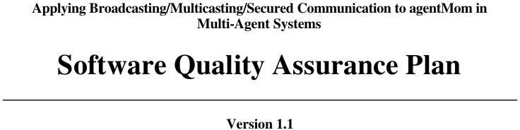

Slide 33
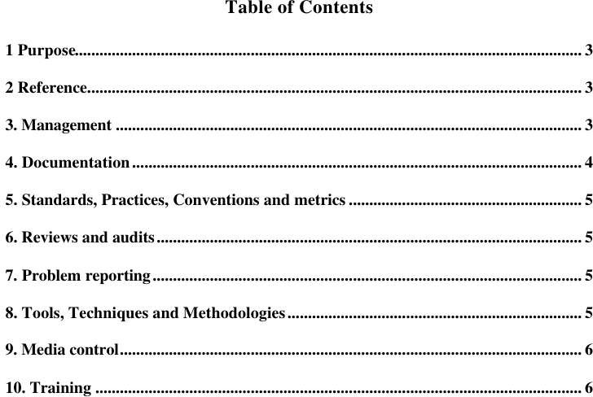

Slide 34
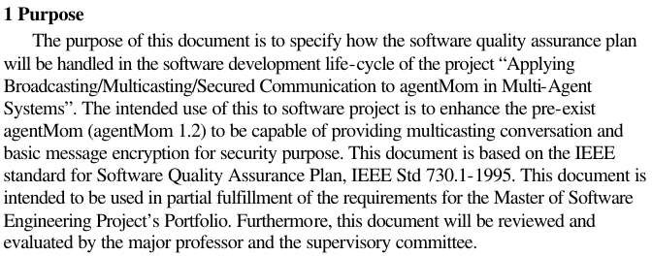

Slide 35
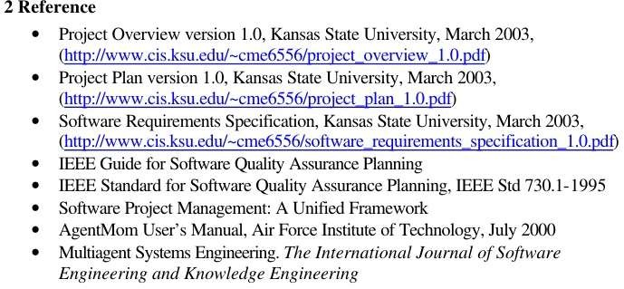

Slide 36
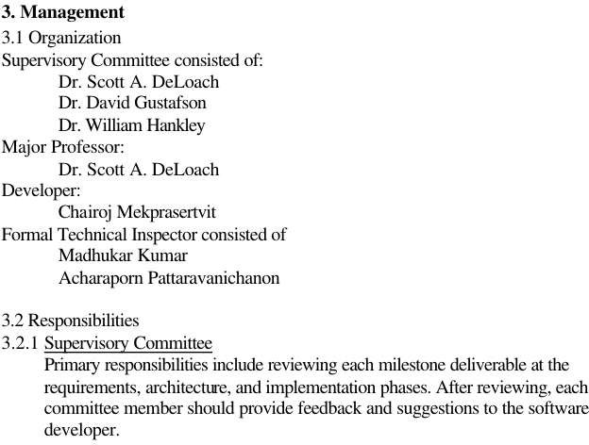

Slide 37
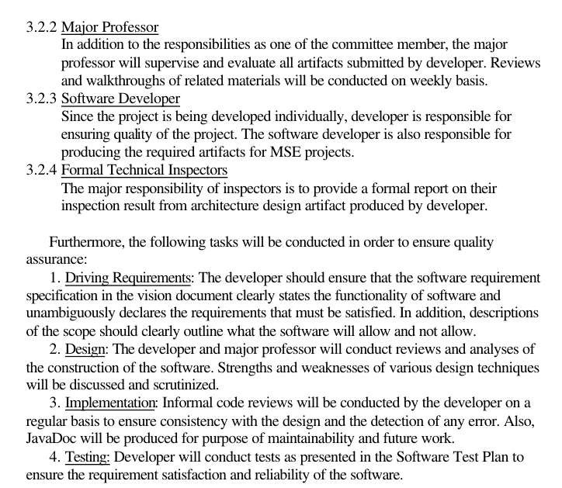

Slide 38
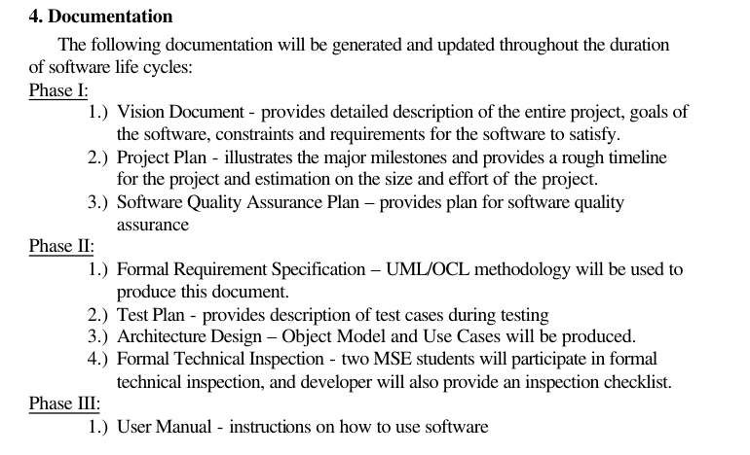

Slide 39
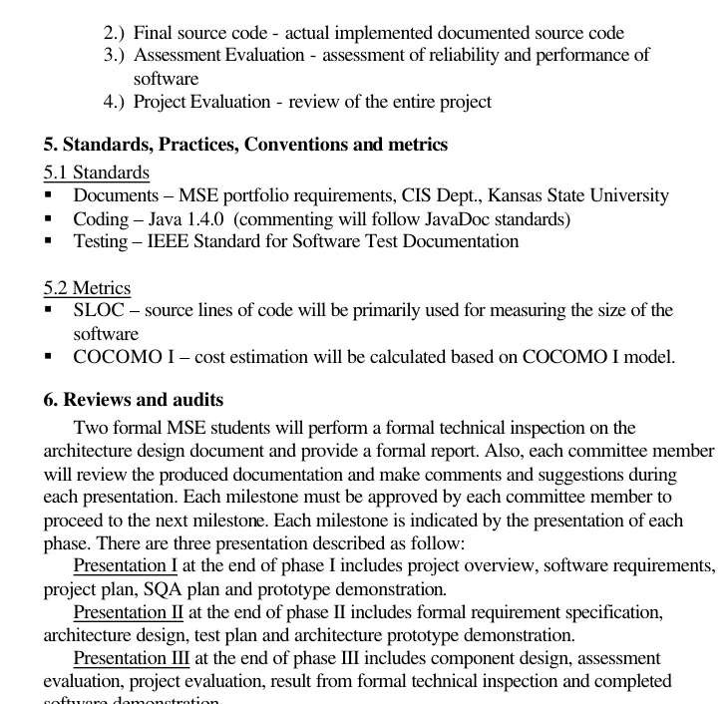

Slide 40
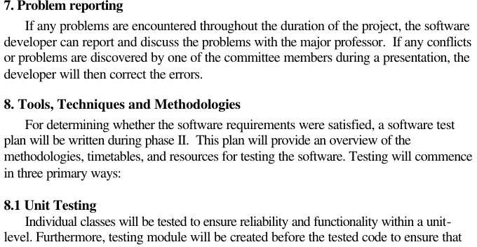

Slide 41
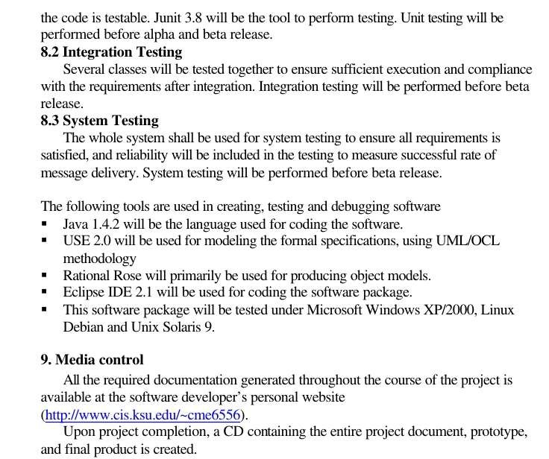

Slide 42
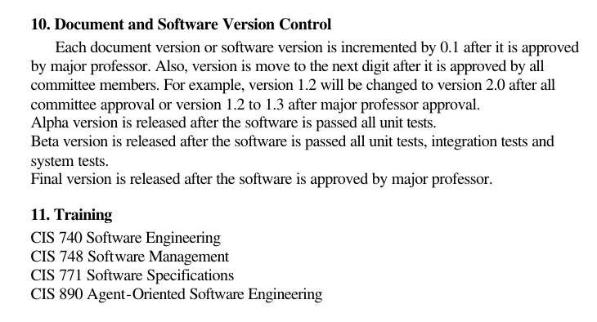

Slide 43
SQA CONSIDERATIONS
SQA organizations are rarely staffed with sufficiently experienced or knowledgable people because such people usually prefer development/design work, and management often wants them in the latter
The SQA management team often is not capable of negotiating with development. This depends on the caliber of the SQA team
Senior management often backs development over SQA on a very large percentage of issues. Development then ignores the SQA issues, and SQA degenerates into a series of lowlevel, useless debates.
Many SQA organizations operate without suitably documented and approved development standards and procedures; without such standards, they do not have a sound basis for judging developmental work, and every issue becomes a matter of opinion.
Development also wins such generalized debates when schedules are tight
Software development groups rarely produce verifiable quality plans. SQA is then trapped into arguments over specific defects rather than overall quality indicators. SQA may win the battle but lose the war

Slide 44
Need of Software Quality Assurance
It saves your money and time
Stable and Competitive Product
Safety
Reputation
It helps meet clients’ demands and expectations most fully
New suggestions and views on your project

Slide 45
SQA Benefits
Eliminate errors when they are still inexpensive to correct
Improves the quality of the software
Improving the process of creating software
Create a mature software process

Slide 46
SQA Peoples
SQA Engineer
SQA Trustees
SQA Committees
Permanent committees
Ad hoc committees

